Slide 1
Session 2 – Abstraction and Testing Data Skills for Research Kellogg Research Support
August 14, 2023

Slide 2
Three Lessons
Declarative > Procedural
Modular > Monolithic
Automatic > Manual
Notes:
All these things turn procedural unspoken knowledge into explicit, declarative and executable specifications

Slide 3
Roadmap
Declarative Practices
Specify your environment
Use code, not your mouse
Use source control
Modules
Structure code into functions
Group functions into files
Write unit tests
Command Line Interfaces
Turn your code into scripts
Notes:
All these things turn procedural unspoken knowledge into explicit, declarative and executable specifications

Slide 4
1. Declarative Practices
Declarative > Procedural
Modular > Monolithic
Automatic > Manual
Notes:
All these things turn procedural unspoken knowledge into explicit, declarative and executable specifications

Slide 5

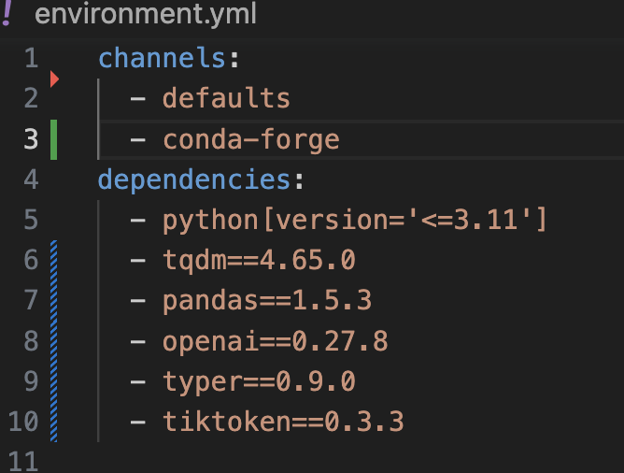
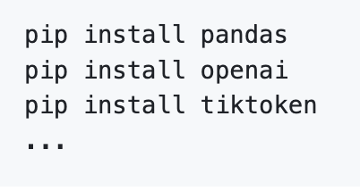
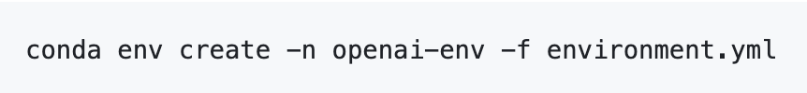
Specify Environments

Slide 6
Code vs. Mouse

Slide 7
Source Control

Slide 8
2. Modularity
Declarative > Procedural
Modular > Monolithic
Automatic > Manual
Notes:
All these things turn procedural unspoken knowledge into explicit, declarative and executable specifications

Slide 9

Abstracting Code into Modules
Modularity: breaking code down into manageable, configurable, cohesive, and maintainable chunks

Slide 10
Benefits of Modules

Slide 11
Functions as Modules
The basic way to organize code is into functions and groups of functions
Functions can be included in core language
Functions can be added through 3rd party libraries
Functions can be also be user defined
But don’t reinvent the wheel
Example: Python’s numpy vs. roll your own: numpy is orders of magnitude faster, and much less likely to have bugs
But beware of poorly documented or maintained 3rd party code

Slide 12
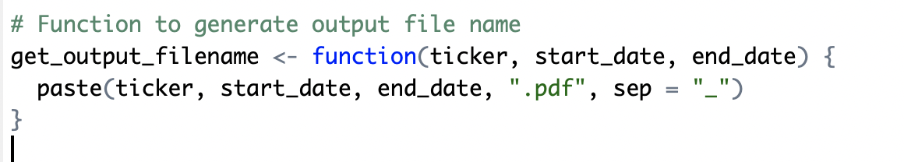


Guidance for Defining Functions
Functions should extract logic into a single source of truth
Each function should do only one thing – keep it simple
Organize functions into groups (files, packages)
Test function inputs with assertion statements
Test function with unit tests
Caveat: a function can be too simple to be worth the trouble:
Prompt: what could we add to make such a function worthwhile?

Slide 13
Monolithic Code
// Load the "nlswork" dataset (if not already loaded)
use https://www.stata-press.com/data/r17/nlswork.dta
// Subset the dataset for the year 1976
keep if year == 76
// Run fixed effects regression for the year 1976
xtreg wage, fe
estout, title("Fixed Effects Reg by Year 1976") cells(b(star fmt(%9.3f)) se(fmt(%9.3f))) replace
// Subset the dataset for the year 1978
use https://www.stata-press.com/data/r17/nlswork.dta, clear
keep if year == 78
// Run fixed effects regression for the year 1978
xtreg wage, fe
estout, title("Fixed Effects Reg by Year 1978") cells(b(star fmt(%9.3f)) se(fmt(%9.3f))) replace

Slide 14
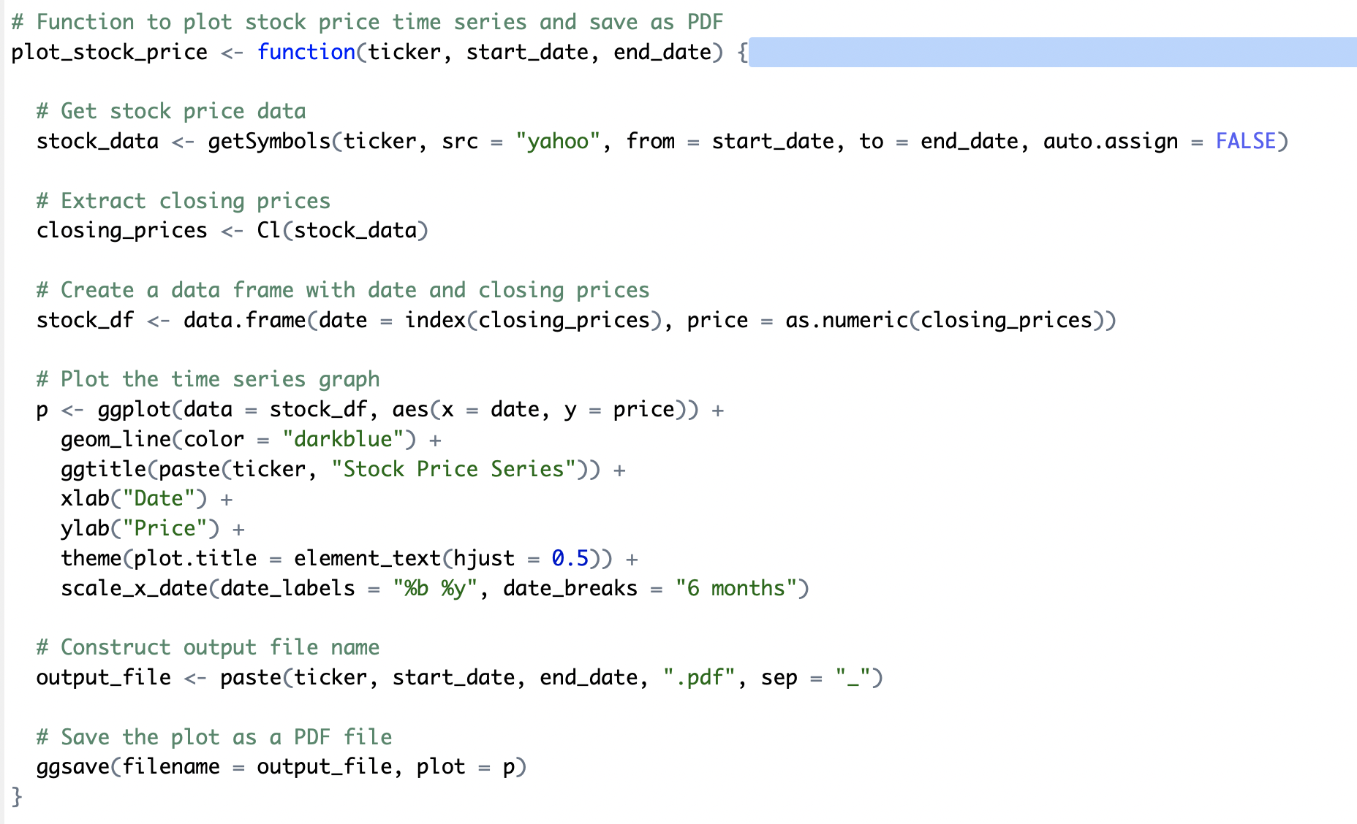
Do Everything Functions

Slide 15
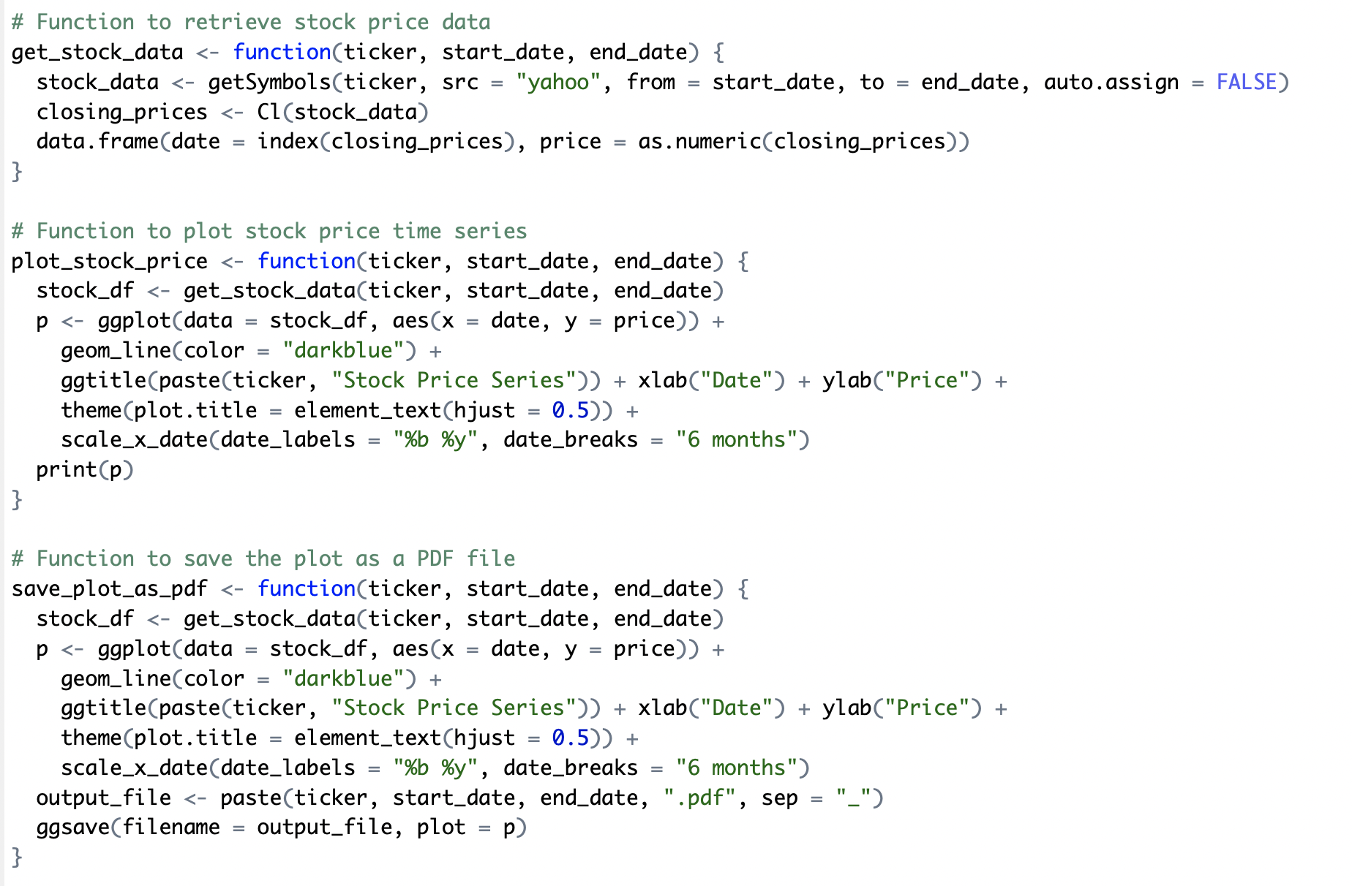
Modular Functions

Slide 16
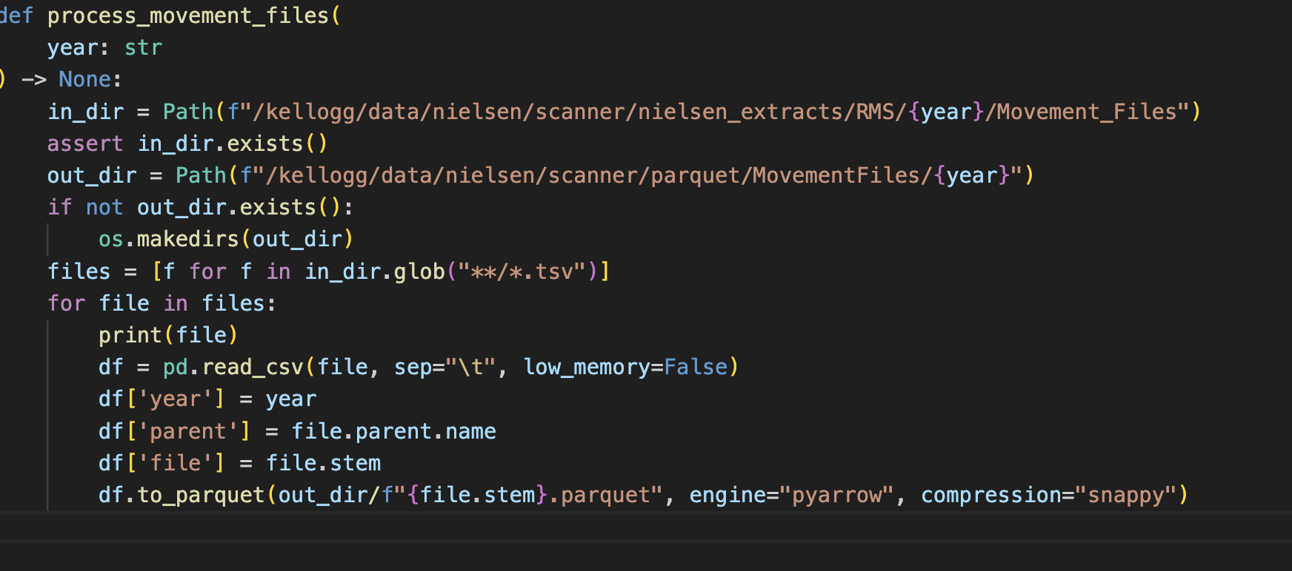
Validating Function Inputs

Slide 17
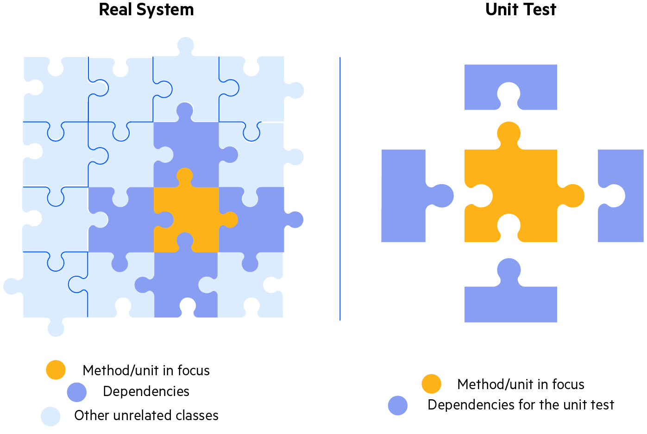
Testing Code
Unit Tests :
The goal of unit testing is to test a single “unit” of the code in isolation.
For instance, execute a single function with a range of inputs and validate the corresponding outputs

Slide 18
Unit Tests
Proper unit testing is automatic, not manual
Each unit test has three parts:
setup input
activate code, and
assert result
Best to write code and tests at the same time!
Assertions around testing… does this file exist.

Slide 19
Python Example

Slide 20
Testing a Function (unit test the R functions)
Good test: does directory/file exist already?
Inspecting content of file
Unit tests for the function that processes files in a given directory/year
Demonstrate utility of assertions/exceptions over silently failing
Making assumptions explicit:
Good -- Comment the assumptions for a functions
Better -- Use assert statements to test for your assumptions

Slide 21
3. Automation
Declarative > Procedural
Modular > Monolithic
Automatic > Manual
Notes:
All these things turn procedural unspoken knowledge into explicit, declarative and executable specifications

Slide 22
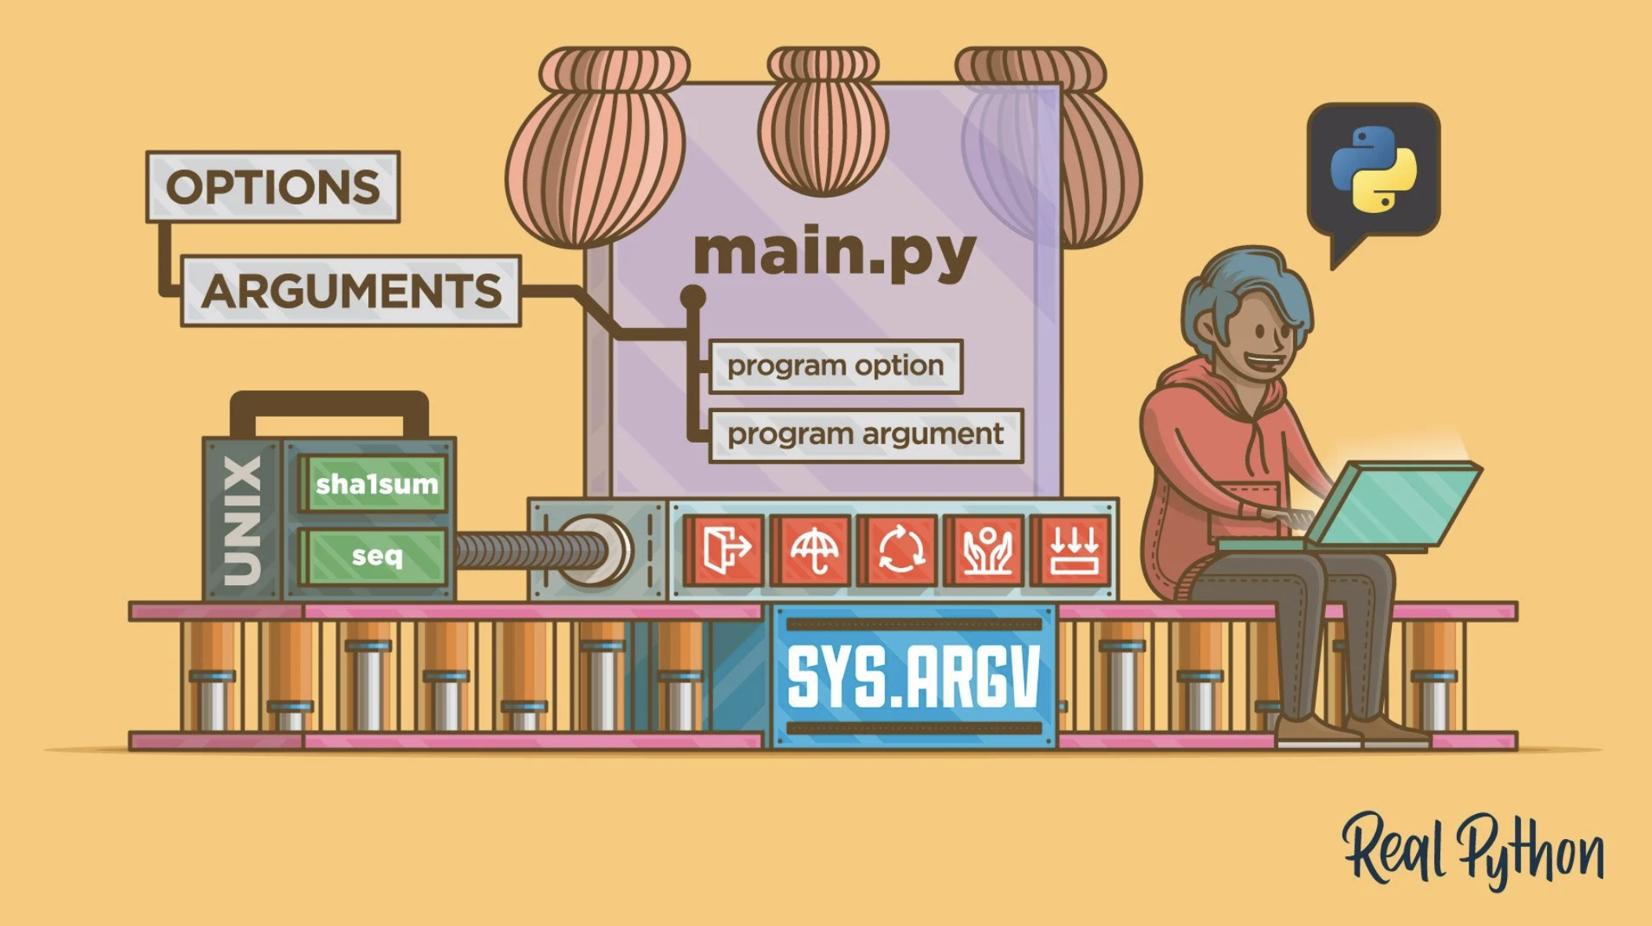
Command Line Interfaces

Slide 23
Command Line Arguments – Examples
Lead with R examples, move to Python/typer
Discussion – Any examples of when you use or would like to use command line arguments?
Run files on another year
Different input parameters, random seeds, bootstrap with 1,000 or 10,000 etc.
Change model specifications, or graphs and titles

Slide 24
Linux Commands (Bash) – more stable
Ask Linux for the date instead of Python/R/Stata
Does a file exist, when was the last time it was touched.
Random sleep, wget concatenate.

Slide 25
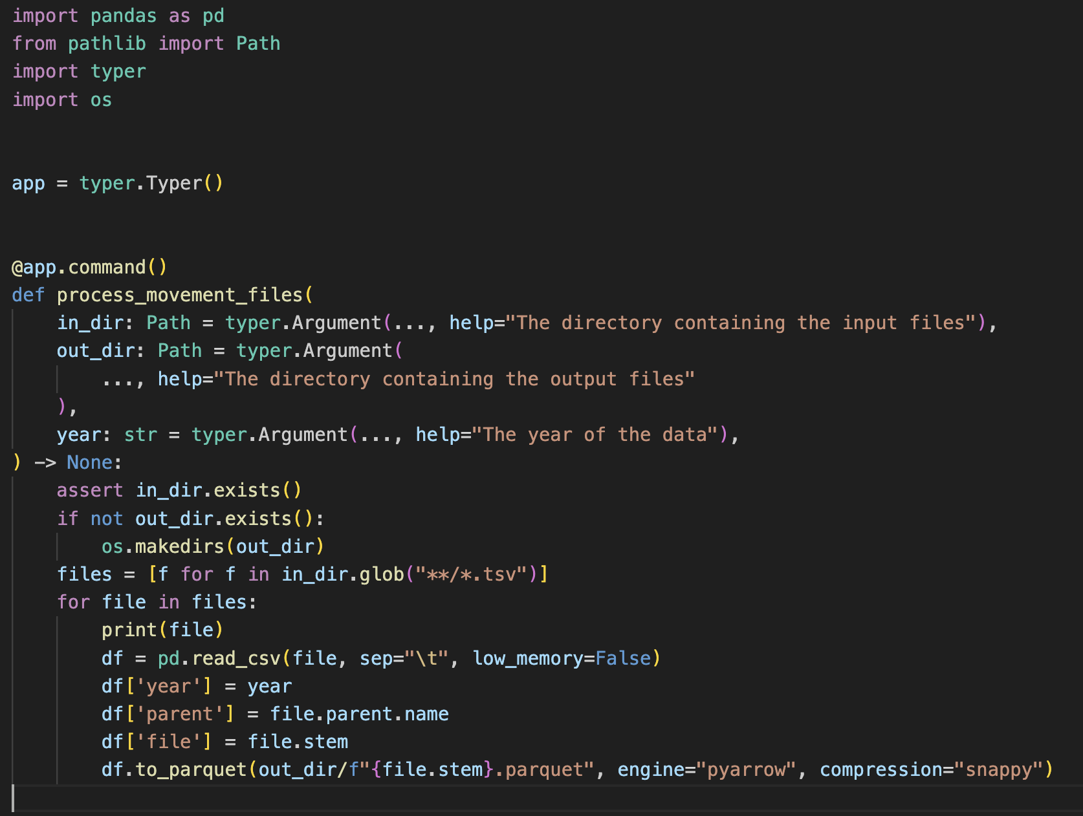
Example: Command Line Interface (CLI)

Slide 26
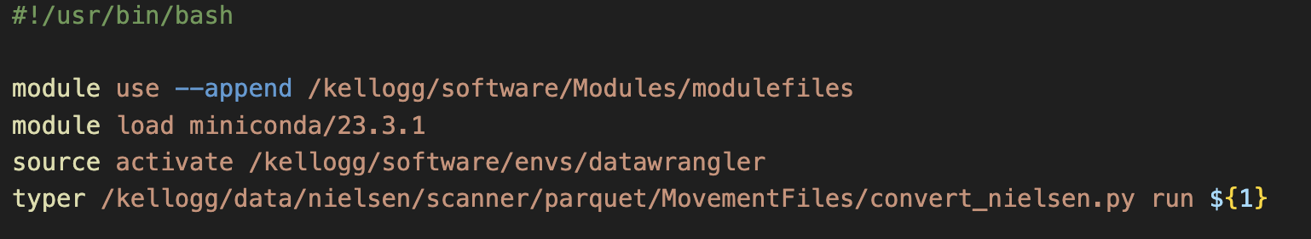

Turn into a Script

Slide 27
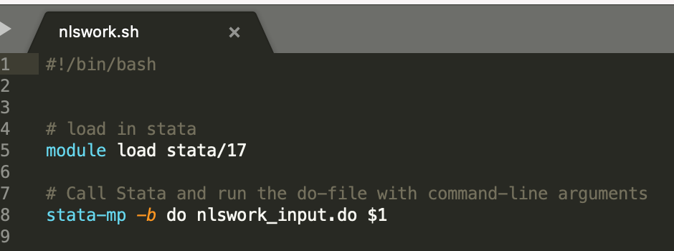
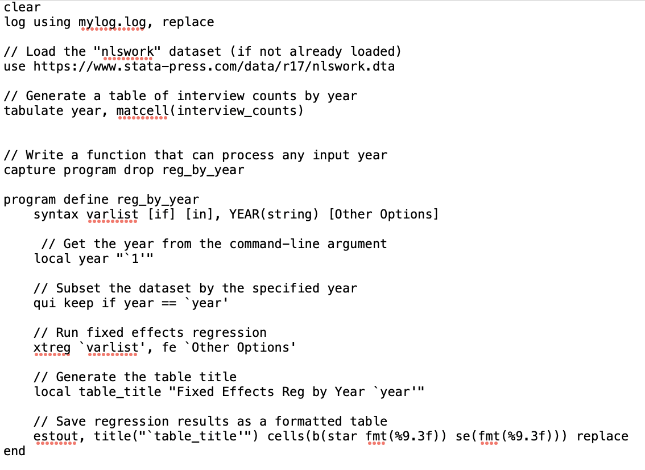
Example: CLI for Stata
nlswork_input.do

Slide 28
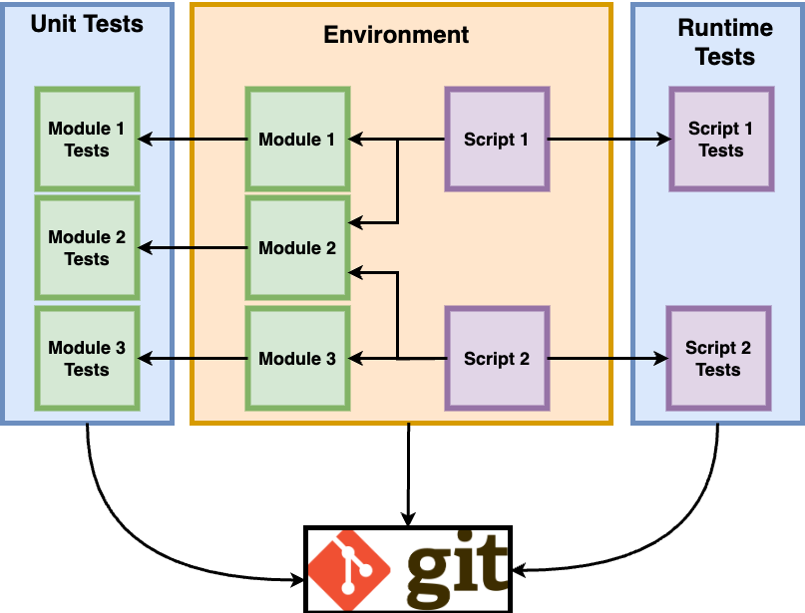
Big Picture
Version Control

